Slide 1
Recap Microdata Protection
SDC COURSE 2025

Slide 2

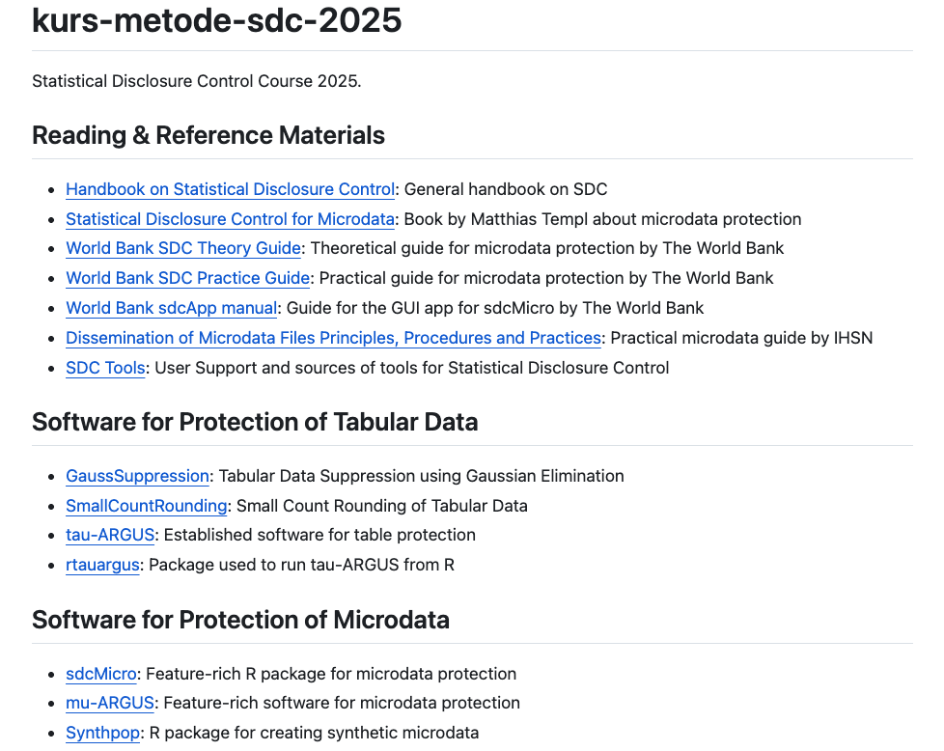

Course Resources
Screenshot from https://github.com/statisticsnorway/kurs-metode-sdc-2025

Slide 3
Statistical Disclosure Control (SDC) for Microdata
Apply
Anonymization Methods
Evaluate
Risk
Evaluate
Utility

Slide 4
The Anonymization Process
Original dataset
Risk
Highest acceptable risk
Optimal solution
No data
Utility

Slide 5
Release Types
Release type | Use case | Degree of anonymization
Raw microdata | Internal use | None
SecUF (Secure Use Files) | Controlled, secure environments | Low
SUF (Scientific Use File) | Microdata to researchers | Medium
PUF (Public Use File) | Microdata to the public | High

Slide 6
Five Safes Framework (all types of data sharing)
Who gets access to the data?
What are the legal obligations of the users?
What are the users intending to do with the data?
In which environment does the users interact with the data?
Does the environment enforce any restrictions on usage?
What is the data about?
How detailed/sensitive is the data?
To which degree is the data anonymized?
What types of output can be produced from the data?
Safe People
Safe Projects
Safe Settings
Safe Data
Safe Outputs
Five Safes: designing data access for research, T. Desai, F. Ritchie and R. Welpton

Slide 7
Classification of Variables
How identifying is each variable?
How sensitive is each variable?
How is each variable measured and represented?
For surveys, what is the weight variable?
For surveys, what are the stratification variables?

Slide 8
Create Initial sdcMicroObj
createSdcObj(
dat,
keyVars,
numVars = NULL,
pramVars = NULL,
ghostVars = NULL,
weightVar = NULL,
hhId = NULL,
strataVar = NULL,
sensibleVar = NULL,
excludeVars = NULL,
options = NULL,
seed = NULL,
randomizeRecords = FALSE,
alpha = 1
)
dat: original dataset to anonymize
keyVars: (categorical) key variables
weigthVar: weight variable
sensibleVar: sensitive variables
excludeVars: variables to exclude from process and output

Slide 9
Delete Direct Identifiers!
Quasi-identifiers
(key variables)
Direct identifiers
Person ID | E-mail | Gender | Birth year | Occupation | Nationality | Income | Job satisfaction | Weight
2102… | jan_krog@... | M | 1950 | Researcher | Norwegian | 42000 | Low | 20
2306… | anna_m@... | F | 1943 | Researcher | German | 49000 | Medium | 35
0105… | lise96@... | F | 1996 | Investor | Norwegian | 349000 | High | 10
2412… | jonas60@... | M | 1960 | Prime minister | Norwegian | 53000 | High | 15
1705… | oliviahh@... | F | 2004 | Student | Norwegian | 0 | High | 40
2308… | jrk@... | M | 1951 | Researcher | Norwegian | 39000 | Low | 20
… | … | … | … | … | … | … | … | …

Slide 10
Delete Direct Identifiers!
Quasi-identifiers
(key variables)
Gender | Birth year | Occupation | Nationality | Income | Job satisfaction | Weight
M | 1950 | Researcher | Norwegian | 42000 | Low | 20
F | 1943 | Researcher | German | 49000 | Medium | 35
F | 1996 | Investor | Norwegian | 349000 | High | 10
M | 1960 | Prime minister | Norwegian | 53000 | High | 15
F | 2004 | Student | Norwegian | 0 | High | 40
M | 1951 | Researcher | Norwegian | 39000 | Low | 20
… | … | … | … | … | … | …

Slide 11
Statistical Disclosure Control (SDC) for Microdata
Apply
Anonymization Methods
Evaluate
Risk
Evaluate
Utility

Slide 12
Sample Frequency f_{k}
Consider each combination k of key variables:
Each such combination is called a key
Let f_{k} be the number of units in sample with a key = k
sdc_0@risk$individual
risk fk Fk
[1,] 0.017144262 2 110.0
[2,] 0.022042326 2 84.5
[3,] 0.022042326 2 84.5
[4,] 0.177075834 1 17.0
[5,] 0.003581243 2 549.0
[6,] 0.003581243 2 549.0
[7,] 0.402359478 1 5.0
Gender | Occupation | f_{k}
M | Professor | 1
F | Investor | 3
F | Software Engineer | 2
F | Investor | 3
M | Researcher | 1
F | Software Engineer | 2
F | Investor | 3

Slide 13
Risk Measure: k-anonymity — Example
Gender | Occupation | f_{k}
F | Investor | 3
F | Investor | 3
F | Investor | 3
M | Professor | 2
M | Professor | 2
M | Researcher | 2
M | Researcher | 2
Gender | Occupation | f_{k}
F | Investor | 3
F | Investor | 3
F | Investor | 3
M | Academic | 4
M | Academic | 4
M | Academic | 4
M | Academic | 4
Recode
Number of records violating
2-anonymity: 0 (0.000%)
3-anonymity: 4 (57.143%)
5-anonymity: 7 (100.000%)
Number of records violating
2-anonymity: 0 (0.000%)
3-anonymity: 0 (0.000%)
5-anonymity: 7 (100.000%)

Slide 14
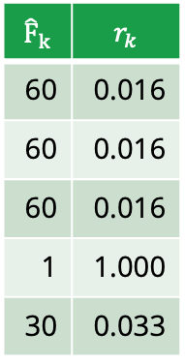
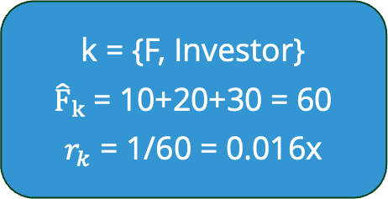

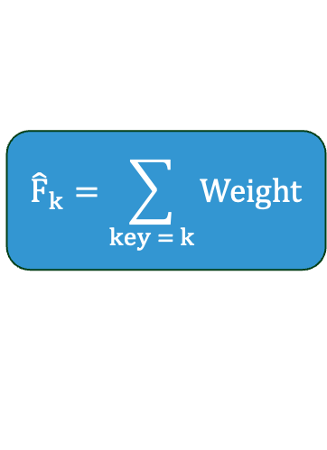
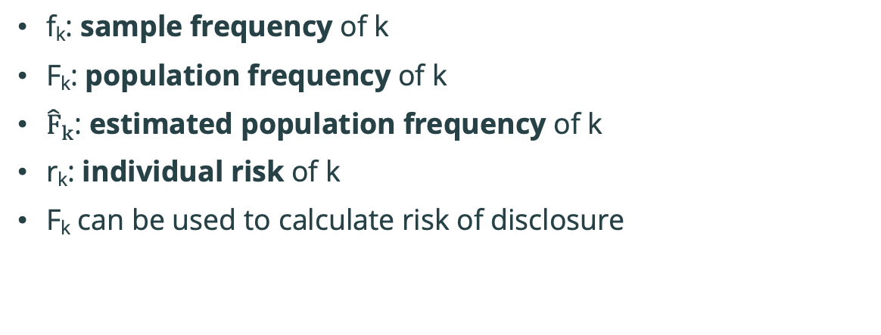
F_{k} and r_{k}
f_{k}: sample frequency of k
F_{k}: population frequency of k
${\hat{F}}_{k}$: estimated population frequency of k
r_{k}: individual risk of k
F_{k} can be used to calculate risk of disclosure
$${\hat{F}}_{k}=\sum_{key = k}{Weight}$$
$$r_{k}=\frac{1}{{\hat{F}}_{k}}$$
Population (100 records)
Gender | Occupation | F_{k}
F | Investor | 50
F | Investor | 50
M | Professor | 10
F | Investor | 50
M | Researcher | 30
F | Software Engineer | 5
F | Investor | 50
M | Software Engineer | 5
M | Prime Minister | 1
… | … | …
(more sophisticated risk formulas exist)
Sample (5 records)
Weight | Gender | Occupation | f_{k}
10 | F | Investor | 3
20 | F | Investor | 3
30 | F | Investor | 3
1 | M | Prime Minister | 1
39 | M | Researcher | 1
$${\hat{F}}_{k}$$ | $$r_{k}$$
60 | 0.016
60 | 0.016
60 | 0.016
1 | 1.000
30 | 0.033
k = {F, Investor}
${\hat{F}}_{k}$= 10+20+30 = 60
$r_{k}$ = 1/60 = 0.016x

Slide 15
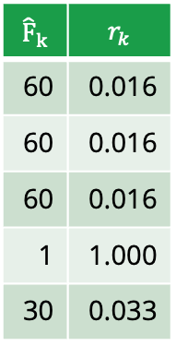
Global Risk Measures
1. Expected number of reidentifications:
sum(r_{k}) = 0.016+0.016+0.016+1.000+0.033 = 1.081
2. Expected fraction of reidentified records:
mean(r_{k}) = 1.081/5 = 0.21
3. Expected percentage of reidentified records:
100 * mean(r_{k}) = 100 * 0.21 = 21
4. Risk of most vulnerable record:
max(r_{k}) = 1.000
Sample (5 records)
Weight | Gender | Occupation | f_{k}
10 | F | Investor | 3
20 | F | Investor | 3
30 | F | Investor | 3
1 | M | Professor | 1
39 | M | Researcher | 1
$${\hat{F}}_{k}$$ | $$r_{k}$$
60 | 0.016
60 | 0.016
60 | 0.016
1 | 1.000
30 | 0.033

Slide 16
The Risk Slot – sdc_0@risk
$individual
risk fk Fk
[1,] 0.017144262 2 110.0
[2,] 0.022042326 2 84.5
[3,] 0.022042326 2 84.5
[4,] 0.177075834 1 17.0
[5,] 0.003581243 2 549.0
[6,] 0.003581243 2 549.0
[7,] 0.402359478 1 5.0
[8,] 0.017144262 2 110.0
$global
$global$risk
[1] 0.08312137
$global$risk_ER
[1] 0.664971
$global$risk_pct
[1] 8.312137
$global$threshold
[1] 0.003581243
$global$max_risk
[1] 0.01

Slide 17
Statistical Disclosure Control (SDC) for Microdata
Apply
Anonymization Methods
Evaluate
Risk
Evaluate
Utility

Slide 18
Anonymization Methods — Overview
Anonymization method | Classification | Data type
Remove variables | Non-perturbative, deterministic | Continuous and categorical
Global recoding | Non-perturbative, deterministic | Continuous and categorical
Top and bottom coding | Non-perturbative, deterministic | Continuous
Rounding | Non-perturbative, deterministic | Continuous
Local suppression | Non-perturbative, deterministic | Categorical
PRAM | Perturbative, probabilistic | Categorical
Microaggregation | Perturbative, probabilistic | Continuous
Noise addition | Perturbative, probabilistic | Continuous
Rank swapping | Perturbative, probabilistic | Continuous
Shuffling | Perturbative, probabilistic | Continuous

Slide 19
Remove Variables
sdcMicro
createSdcObj: excludeVars
removeDirectID()
Remove one or more variables before release
Used on direct identifiers to avoid straightforward identity disclosure
Used on quasi-identifiers (key variables) for additional prevention of identification
Used occasionally on sensitive variables to prevent attribute disclosure
Person ID | E-mail | Gender | Birth year | Occupation | Nationality | Income | Job satisfaction | Weight
2102… | jan_krog@... | M | 1950 | Researcher | Norwegian | 42000 | Low | 20
2306… | anna_m@... | F | 1943 | Researcher | German | 49000 | Medium | 35
0105… | lise96@... | F | 1996 | Investor | Norwegian | 349000 | High | 10
2412… | jonas60@... | M | 1960 | Prime minister | Norwegian | 53000 | High | 15
1705… | oliviahh@... | F | 2004 | Student | Norwegian | 0 | High | 40
2308… | jrk@... | M | 1951 | Researcher | Norwegian | 39000 | Low | 20
… | … | … | … | … | … | … | … | …
Gender | Birth year | Occupation | Nationality | Income | Job satisfaction | Weight
M | 1950 | Researcher | Norwegian | 42000 | Low | 20
F | 1943 | Researcher | German | 49000 | Medium | 35
F | 1996 | Investor | Norwegian | 349000 | High | 10
M | 1960 | Prime minister | Norwegian | 53000 | High | 15
F | 2004 | Student | Norwegian | 0 | High | 40
M | 1951 | Researcher | Norwegian | 39000 | Low | 20
… | … | … | … | … | … | …

Slide 20
sdcMicro
groupAndRename()
globalRecode()
Global Recoding — Example
Region: Discard subregions by only using the first letter
Birth year: Divide into decades
Occupation: Use only “Academic” and ”Other”
Income: Use income ranges
Region | Birth year | Occupation | Income | f_{k}
A-1 | 1960 | Professor | 44300 | 1
A-2 | 1961 | Researcher | 49500 | 1
B-1 | 1962 | Investor | 349800 | 1
B-1 | 1963 | Professor | 53300 | 1
B-2 | 1964 | Student | 83920 | 1
B-3 | 1965 | Researcher | 39800 | 1
Region | Birth year | Occupation | Income | f_{k}
A | 1960-1969 | Academic | [10k,100k) | 2
A | 1960-1969 | Academic | [10k,100k) | 2
B | 1960-1969 | Other | [100k,1M) | 1
B | 1960-1969 | Academic | [10k,100k) | 2
B | 1960-1969 | Other | [10k,100k) | 1
B | 1960-1969 | Academic | [10k,100k) | 2
Recode

Slide 21
sdcMicro
mvTopCoding()
Top and Bottom Coding – Example
Birth year: Top code every year later than 2004 to 2005
Income: Top code every income above 100k
Occupation | Birth year | Income
Professor | 1960 | 44361
Researcher | 1961 | 49544
Investor | 1962 | 349822
Professor | 1963 | 503389
Student | 1964 | 83923
Researcher | 1965 | 39562
Software Engineer | 2008 | 35279
Student | 2005 | 32845
Investor | 2007 | 39804
Occupation | Birth year | Income
Professor | 1960 | 44361
Researcher | 1961 | 49544
Investor | 1962 | >100000
Professor | 1963 | >100000
Student | 1964 | 83923
Researcher | 1965 | 39562
Software Engineer | 2005 | 35279
Student | 2005 | 32845
Investor | 2005 | 39804
Occupation | Birth year | Income
Professor | 1960 | 44361
Researcher | 1961 | 49544
Investor | 1962 | 100000
Professor | 1963 | 100000
Student | 1964 | 83923
Researcher | 1965 | 39562
Software Engineer | 2005 | 35279
Student | 2005 | 32845
Investor | 2005 | 39804
Recode

Slide 22
Rounding
Round values to a given base (e.g. 10, 100, 1k, 10k)
Other types of rounding can also be used (e.g. truncating, round up/down)
Similar to recoding: it reduces the number of categories
Income: Round to closest 10k
Occupation | Birth year | Income
Professor | 1960 | 44361
Researcher | 1961 | 49544
Investor | 1962 | 349822
Professor | 1963 | 503389
Student | 1964 | 83923
Researcher | 1965 | 39562
Software Engineer | 2008 | 35279
Student | 2005 | 32845
Investor | 2007 | 39804
Occupation | Birth year | Income
Professor | 1960 | 40k
Researcher | 1961 | 50k
Investor | 1962 | 350k
Professor | 1963 | 500k
Student | 1964 | 80k
Researcher | 1965 | 40k
Software Engineer | 2005 | 40k
Student | 2005 | 30k
Investor | 2005 | 40k
Recode

Slide 23
Local Suppression
Algorithms aim for a given level of protection with as few suppressions as possible
Example: Suppress the dataset until it satisfies 2-anonymity
Algorithms naturally tend to suppress:
Variables with many different categories
Infrequent values
sdcMicro
localSuppression()
localSupp()
Region | Birth year | Occupation | f_{k}
A | 1960 | Professor | 1
A | 1960 | Researcher | 1
A | 1960 | Investor | 1
A | 1960 | Dentist | 1
B | 1960 | Professor | 1
B | 1965 | Professor | 1
Region | Birth year | Occupation | f_{k}
A | 1960 | <NA> | 4
A | 1960 | <NA> | 4
A | 1960 | <NA> | 4
A | 1960 | <NA> | 4
B | <NA> | Professor | 2
B | <NA> | Professor | 2
Suppress

Slide 24
sdcMicro
pram()
PRAM
Probabilistic method that changes the values according to a transition matrix P
To region
 | 0.8 | 0.1 | 0.1
 | 0 | 0.9 | 0.1
 | 0 | 0 | 1
 | A | B | C
A | 0.8 | 0.1 | 0.1
B | 0 | 0.9 | 0.1
C | 0 | 0 | 1
From region
Region | Occupation
A | Professor
A | Researcher
A | Investor
B | Professor
B | Researcher
Region | Occupation
A | Professor
A | Researcher
A | Investor
B | Professor
B | Researcher
A | Professor
PRAM
B | Researcher
A | Investor
B | Professor
C | Researcher

Slide 25
Statistical Disclosure Control (SDC) for Microdata
Apply
Anonymization Methods
Evaluate
Risk
Evaluate
Utility

Slide 26
General Utility Measures
sdcMicro
dUtility()
infoLoss()
IL_correl()
IL_variables()
Use general utility measures
Compare the dataset before and after anonymization
Examples:
Number of suppressed values (in total or per variable)
Number of changed values (in total or per variable)
Changes in contingency tables
Contingency Table-Based Information Loss (CTBIL)¹
Original
Anonymized
 | A | B | C
M | 5 | 4 | 8
F | 4 | 5 | 7
 | A | B | C
M | 5 | 0 | 8
F | 2 | 9 | 6
1) Disclosure Protection Methods and Information Loss for Microdata, J Josep Domingo-Ferrer and V. Torra

Slide 27
Microaggregation

Slide 28
Microaggregation
Split records into groups with similar records
Replace their value with an aggregation of the values in the group
mean(40k, 50k, 50k, 60k) = 50k
mean(90k, 100k) = 95k
Region | Income
A | 40k
A | 50k
A | 50k
A | 60k
B | 90k
B | 100k
Region | Income
A | 50k
A | 50k
A | 50k
A | 50k
B | 95k
B | 95k
Microaggregate

Slide 29
Microaggregation
Split records into groups with similar records
Replace their value with an aggregation of the values in the group
median(40k, 50k, 50k,) = 50k
median(60k, 90k, 100k) = 90k
Region | Income
A | 40k
A | 50k
A | 50k
A | 60k
B | 90k
B | 100k
Region | Income
A | 50k
A | 50k
A | 50k
A | 90k
B | 90k
B | 90k
Microaggregate

Slide 30
Microaggregation
Most suited for continuous data, but can be extended to categorical data
Grouping can be based on the same variable, or other variables
Groups can be of any size
Groups of the same size is often desired
Large groups usually gives better protection than small groups
Useful aggregation functions:
Mean
Median
Mode
sdcMicro
microaggregation()
microaggrGower()

Slide 31
Thank you!

